Slide 1
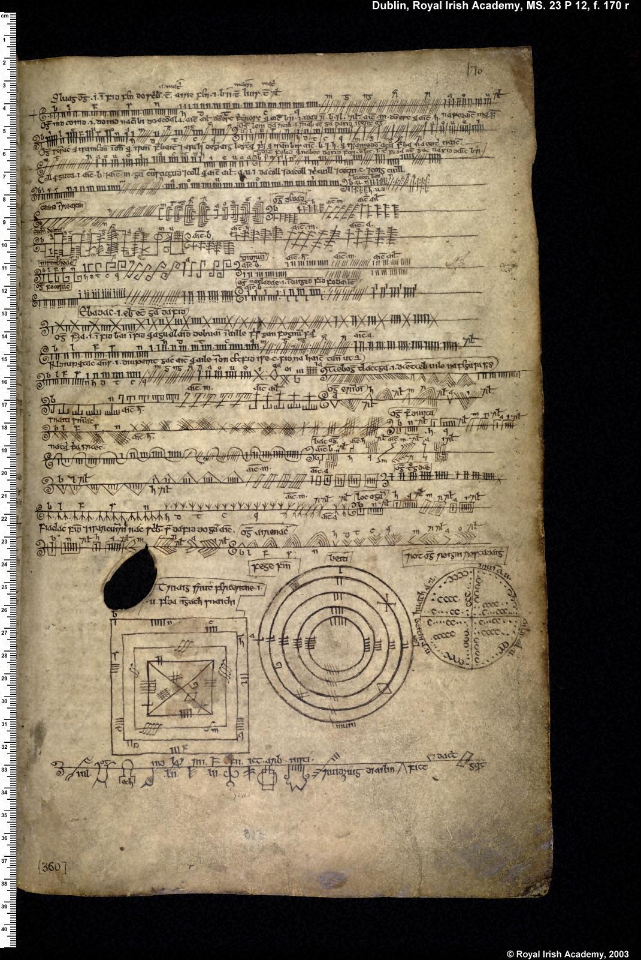
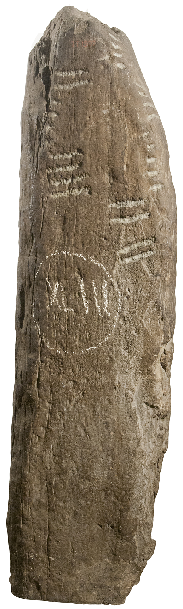
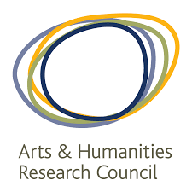



ᚑᚌ(ᚆ)ᚐᚋ
OG(H)AM
Harnessing Digital Technologies to Transform Understanding of Ogham Writing, from the 4th Century to the 21st
Goals | Digitise (in 2D and 3D) all c.640 examples of ogham from its appearance in c. 4th century CE until its modern revival c.1850 Develop an online corpus of ogham based on the existing database of ogham stones in Ireland (Ogham in 3D - https://ogham.celt.dias.ie) but extending the scope to ogham outside Ireland and beyond stone monuments to include portable objects, graffiti, and manuscripts Utilise digital tools for epigraphic and linguistic analysis Gain new insights into ogham (history, development, use, language change…) Engage with other digital epigraphy projects regarding standards and interoperability
Researchers | Prof Katherine Forsyth (PI UK), Prof David Stifter (PI IRE) Dr Deborah Hayden (CI IRE) Dr Megan Kasten (UK), Dr Nora White (IRE) Dr Luca Guariento, Digital Officer (UK)
Universities | University of Glasgow (UK) Maynooth University (IRE)
Date | 1 Aug 2021 – 31 July 2024
Funders | AHRC, IRC
© National Museum of Ireland
Epigraphy.info Workshop VI · October 20th-22nd, 2021

Slide 2
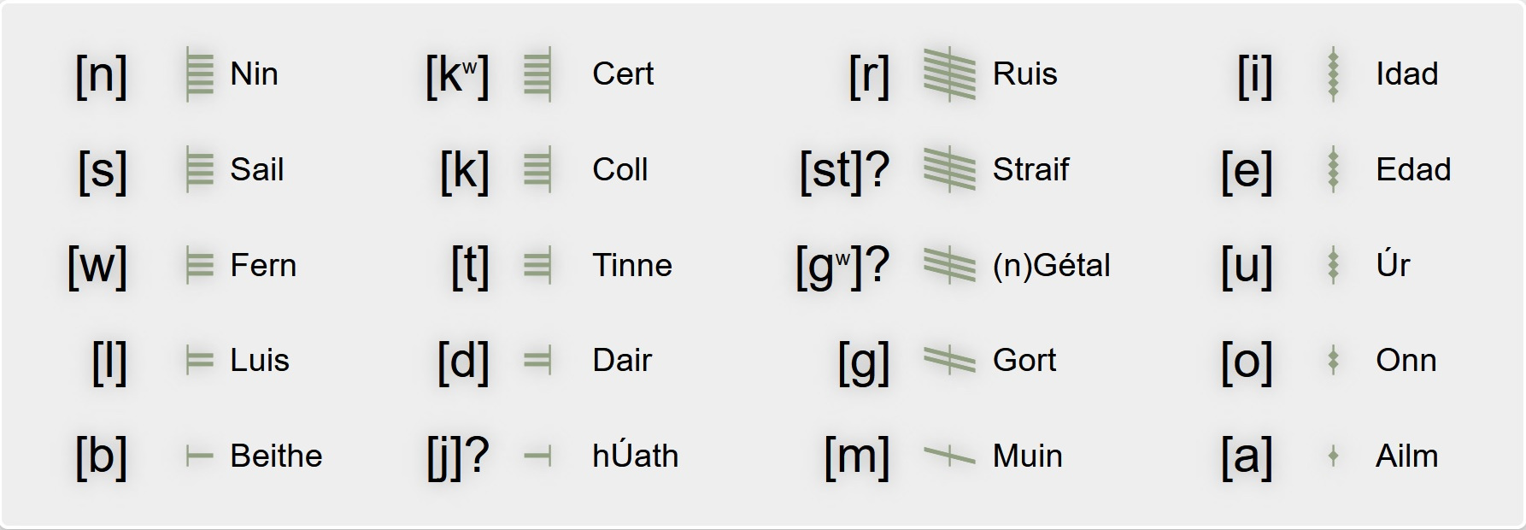
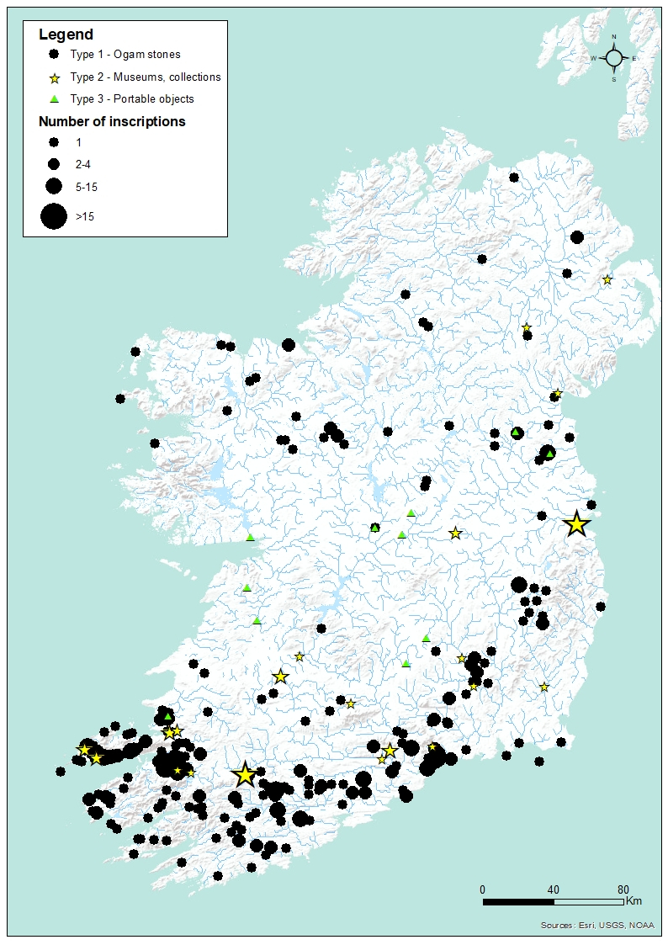
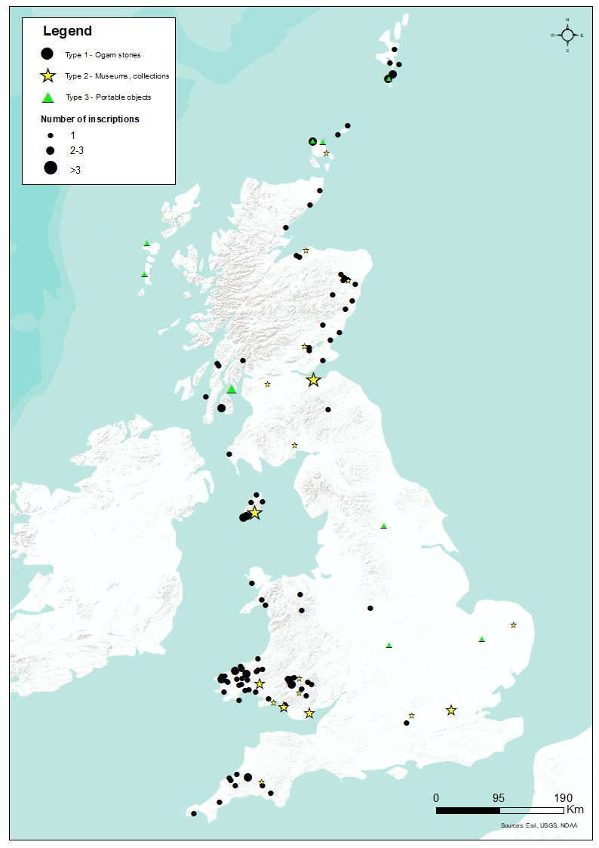
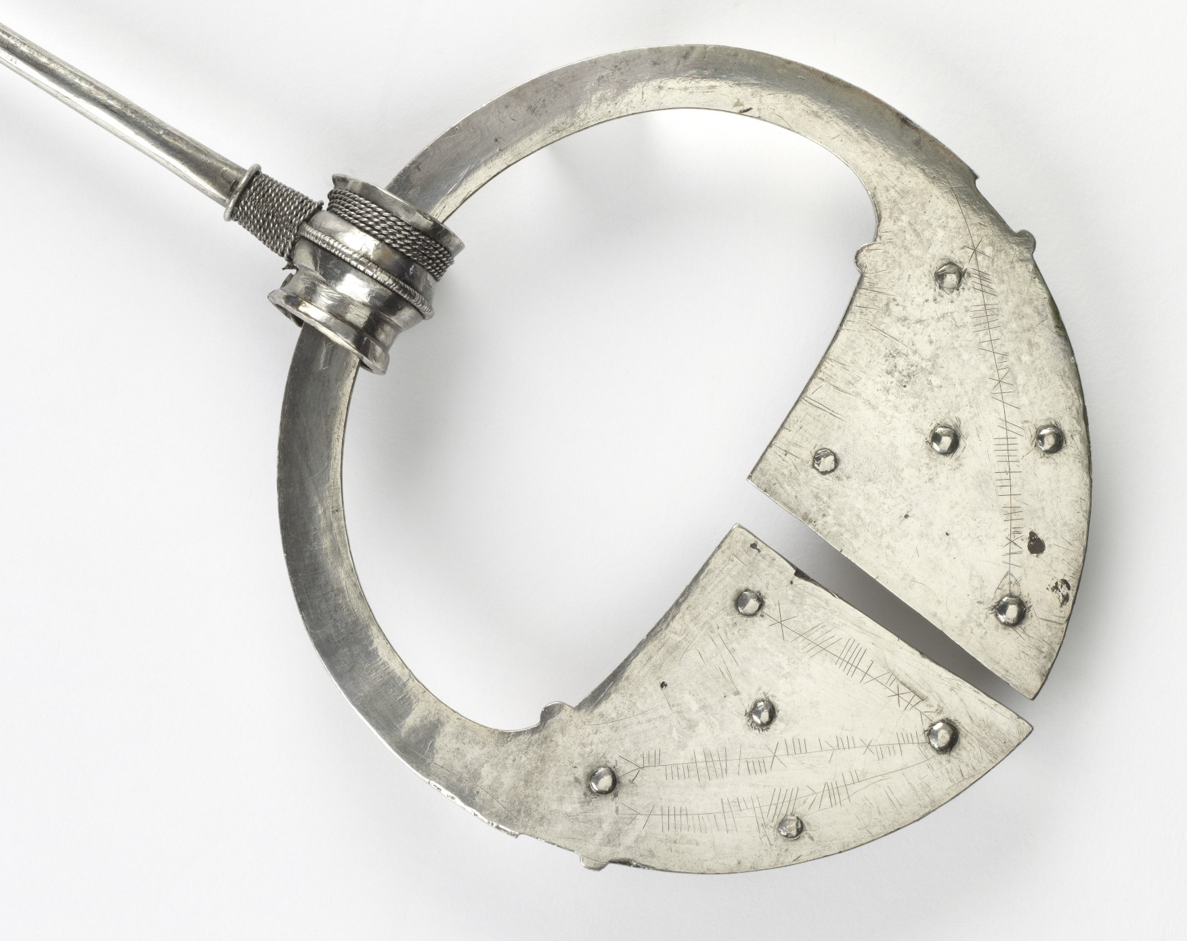
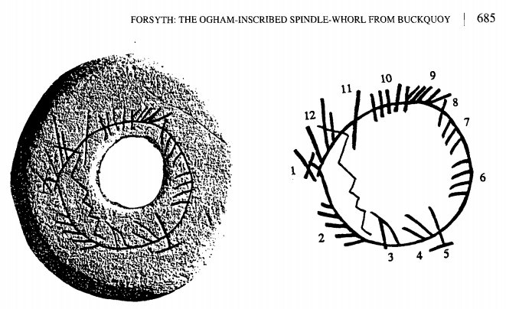
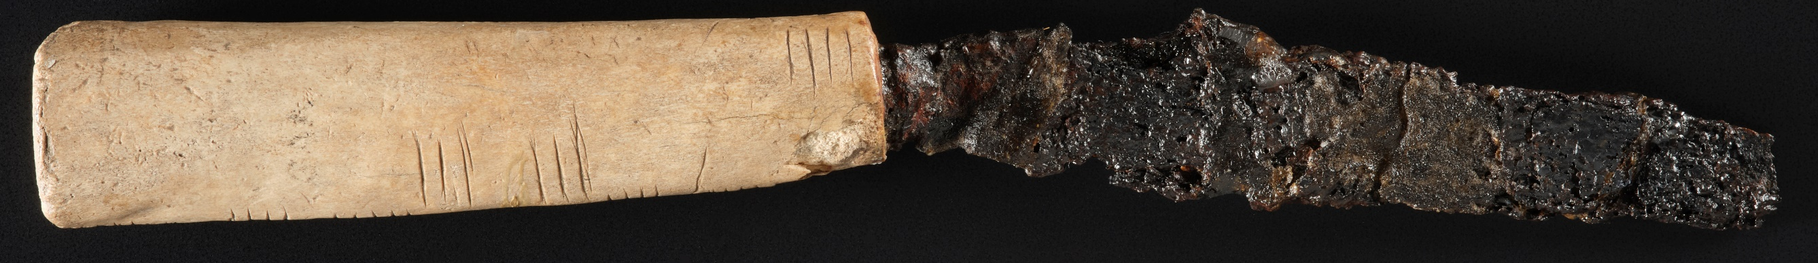
OG(H)AM
ᚑᚌ(ᚆ)ᚐᚋ
Ogham is the earliest written evidence for the language ancestral to Modern Irish, Scottish Gaelic and Manx. The archaic stage of the language preserved gives Ogham importance for the study of CELTIC languages, especially ONOMASTICS, and INDO-EUROPEAN Studies more generally.
Ogham's extremely unusual nature makes it of particular COMPARATIVE INTEREST to EPIGRAPHY (including RUNOLOGY), GRAPHOLINGUISTICS (the study of writing systems), LITERACY studies, and the history of CRYPTOGRAPHY.
Multimedial Ogham
In collaboration with 4 state heritage agencies and 5 national museums we will use Digital Humanities methods and tools to enhance access to, understanding of, and engagement with, a unique cultural heritage which spans all six nations of Britain, Ireland and Man.
The OG(H)AM project will promote understanding of the complexity and time-depth of migration and multi-cultural exchange between Britain, Ireland and Man, and greater awareness of the three islands’ common cultural inheritance and interconnectedness.
© National Museum of Ireland
© National Museum of Scotland
Epigraphy.info Workshop VI · October 20th-22nd, 2021

Slide 3
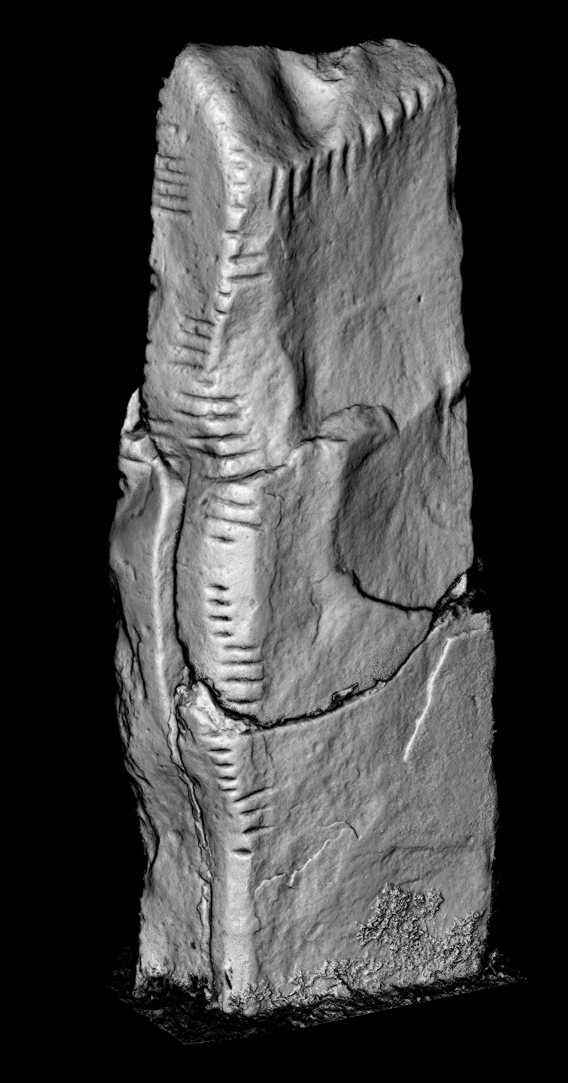
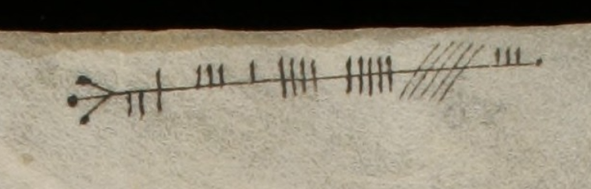
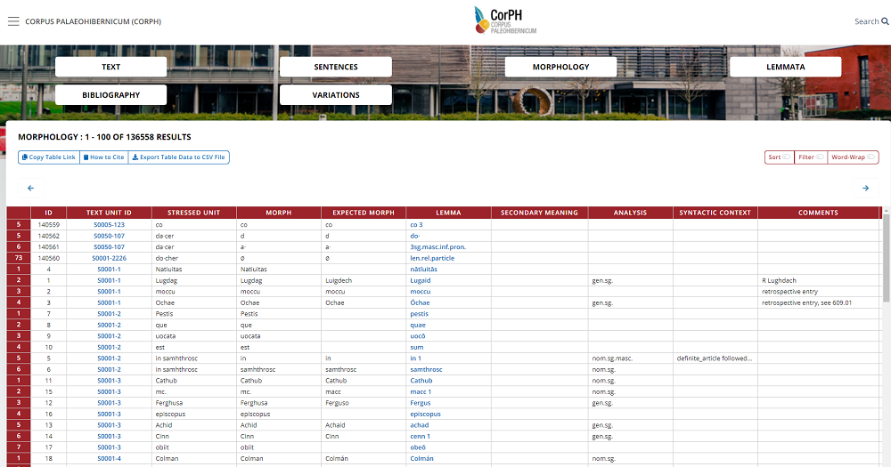
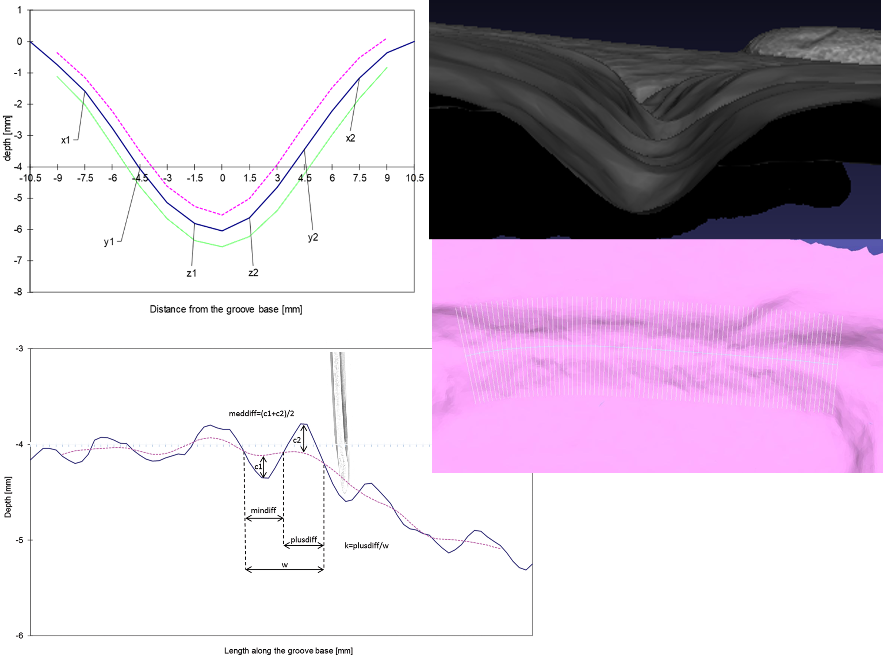
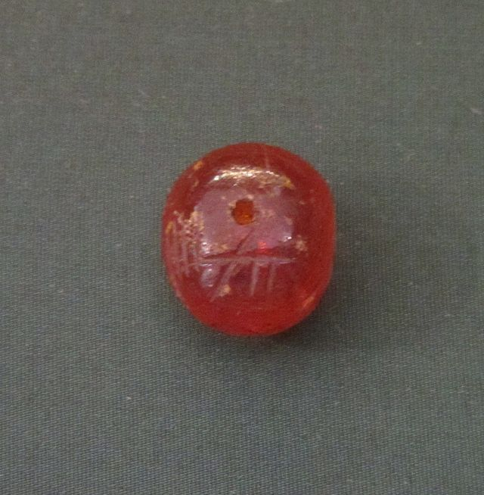
ᚑᚌ(ᚆ)ᚐᚋ
OG(H)AM
RESEARCH QUESTIONS
- how can we harness digital technologies to transform understanding of the ogham tradition in its entirety?
- how can we advance 3D digital methods for analysis as well as documentation of carved stone (specifically, using groove and wear analysis to identify the work of individual carvers and reconstruct worn detail)?
- how can we ensure sustainability and interoperability of complex, multi-disciplinary data sets?
© e-codices, Stiftsbibliothek St Gallen
Digital editions of ogham texts encoded in XML following digital epigraphy standards such as EpiDoc
3D recording and visualisation
Ogham-inscribed amber bead
Ennis, Co. Clare (British Museum)
Groove analysis: a method developed at the Archaeological Research Laboratory at Stockholm University for rune inscriptions.
OG(H)AM linguistic data will be added to the recently launched lexicographic database (CorPH) of the Chronologicon Hibernicum project (https://chronhib.maynoothuniversity.ie/) in order to apply innovative corpus-linguistic methods (variation tagging, Bayesian Language Variation Analysis) to track linguistic changes across the ogham corpus
Epigraphy.info Workshop VI · October 20th-22nd, 2021

